Slide 1
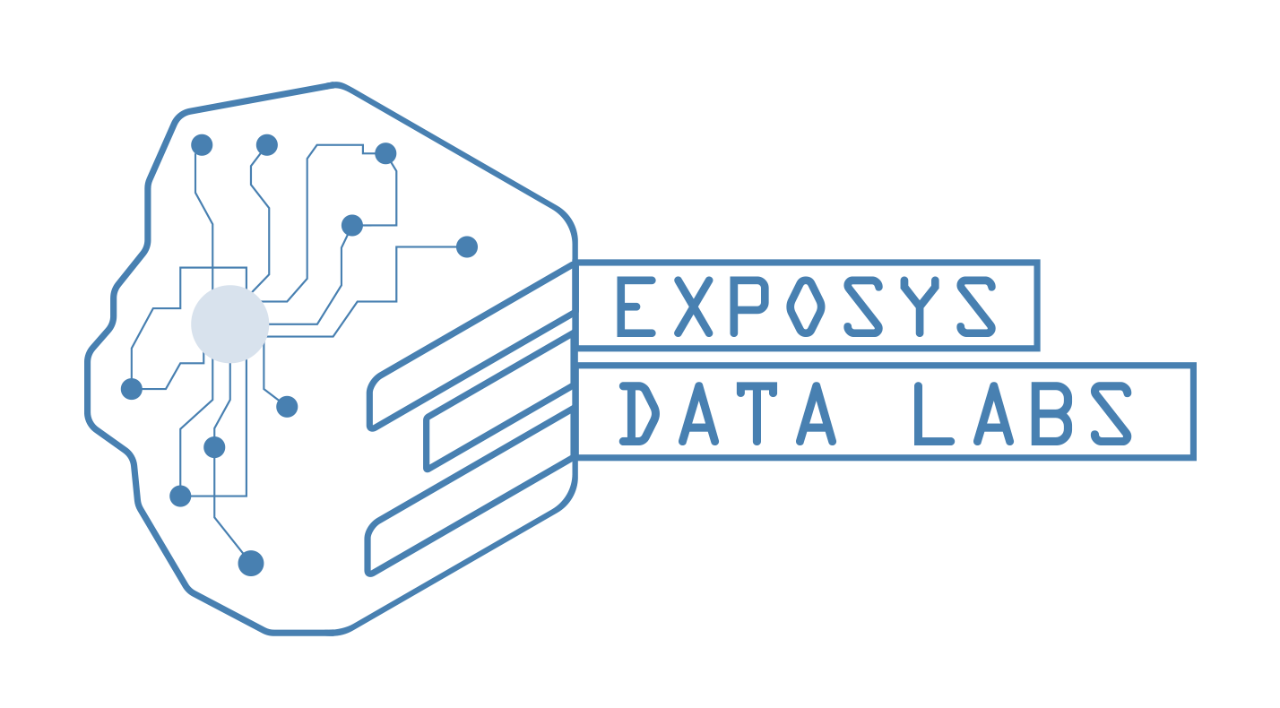
PROJECT PRESENTATION ON CUSTOMER SEGMENTATION
Presented by
T.N.V.S.VATSAL

Slide 2
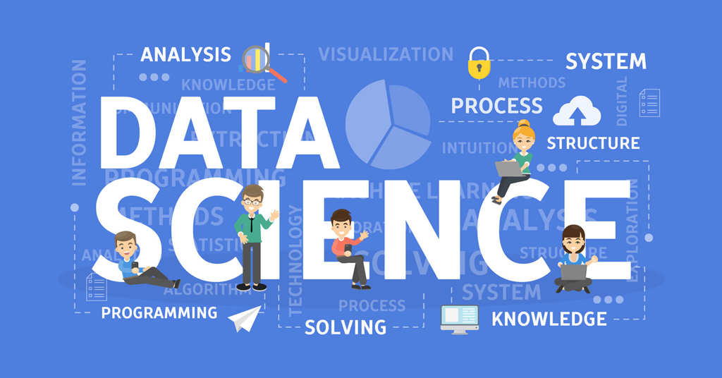

Slide 3
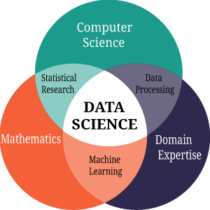

Slide 4
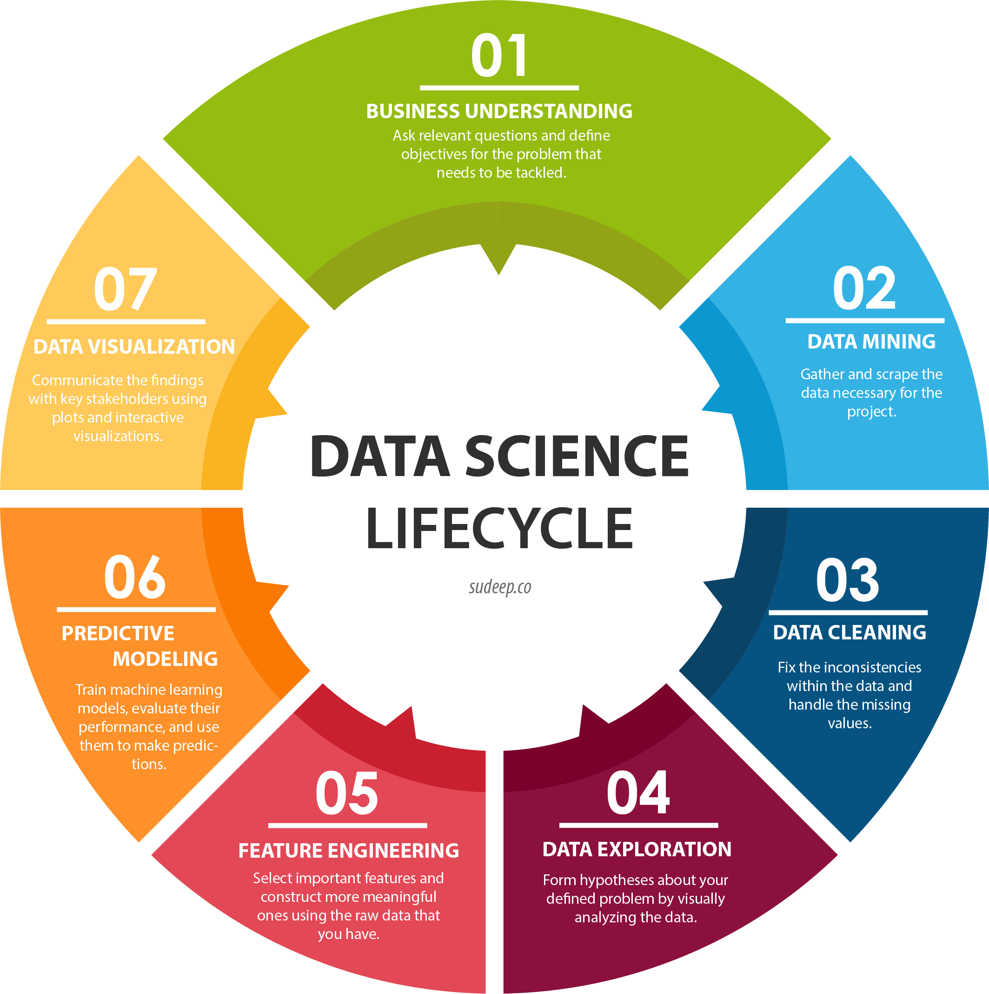

Slide 5
Customer Segmentation Using K Means Clustering
Customer Segmentation is the subdivision of a market into discrete customer groups that share similar characteristics. Customer Segmentation can be a powerful means to identify unsatisfied customer needs. Using the above data companies can then outperform the competition by developing uniquely appealing products and services.
Customer segmentation is the practice of dividing a company’s customers into groups that reflect similarity among customers in each group. The goal of segmenting customers is to decide how to relate to customers in each segment in order to maximize the value of each customer to the business.
The most common ways in which businesses segment their customer base are:
Demographic information, such as gender, age, familial and marital status, income, education, and occupation.
Geographical information, which differs depending on the scope of the company. For localized businesses, this info might pertain to specific towns or counties.
Psychographics, such as social class, lifestyle, and personality traits.
Behavioral data, such as spending and consumption habits, product/service usage, and desired benefits.

Slide 6
Advantages of Customer Segmentation
Determine appropriate product pricing.
Develop customized marketing campaigns.
Design an optimal distribution strategy.
Choose specific product features for deployment.
Prioritize new product development efforts.
Better customer relationship.
Improves channel of distribution.

Slide 7
Problem Statement
You are owing a supermarket mall and through membership cards, you have some basic data about your customers like Customer ID, age, gender, annual income and spending score. You want to understand the customers like who are the target customers so that the sense can be given to marketing team and plan the strategy accordingly.

Slide 8
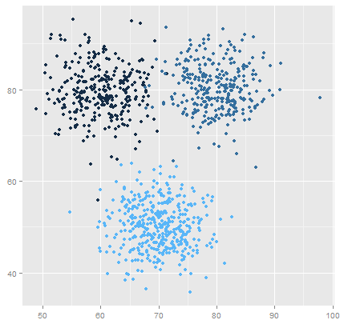
K means Clustering Algorithm
1. Specify number of clusters K.
2. Initialize centroids by first shuffling the dataset and then
randomly selecting K data points for the centroids without replacement.
3. Keep iterating until there is no change to the centroids. i.e assignment of data points to clusters isn’t changing.

Slide 9
Environment and tools
1. Scikit-learn
2. Seaborn
3. Numpy
4. Pandas
5. Matplotli

Slide 10
Conclusion
The main aim of this project is to design and implement Customer Segmentation methods using K means clustering algorithm and it has been achieved successfully.
K means clustering is one of the most popular clustering algorithms and usually the first thing practitioners apply when solving clustering tasks to get an idea of the structure of the dataset. The goal of K means is to group data points into distinct non-overlapping subgroups. One of the major application of K means clustering is segmentation of customers to get a better understanding of them which in turn could be used to increase the revenue of the company.

Slide 11
Thank you

